Slide 1

Pari Manouchehri May 15th, 2020

Slide 2

Project Outline:
Q: How accurately can Corona Virus Confirmed Rates be predicted ?
Introduction
EDA
Cleaning Dataset
Analyze Dataset
Feature Engineering:
Data Preparation(Encoding with Factorize )
Applying Dimensional Reduction
Modeling with Python
Supervised Learning
Logistic Regression
Random Forest Classifier
Support Vector Classification
Optimizing Models by Hyperparameter Optimization with RandomizedSearchCV
Important Features
Unsupervised Learning (Clustering)
Kmeans
Hierarchical clustering
Density-Based Spatial Clustering of Applications with Noise (DBSCAN)DBSCAN
Clustering with Gaussian Mixture Models (GMM)
Modeling with PySpark
Supervised Learning
Logistic Regression with/without Pipeline
Random Forest Classifier with/without Pipeline
Optimizing Models by Hyperparameter Optimization with Cross Validator
Unsupervised Learning (Clustering)
Kmeans
Clustering with Gaussian Mixture Models (GMM
Conclusion
Future Work

Slide 3
Introduction:
Coronavirus disease is an infectious disease caused by a newly discovered corona virus. This virus has now spread throughout the world.
The he pandemic spread has been analyzed by using data from all around the world including several demographic data.
The dataset was taken from different Kaggle datasets on date 05.05.2020
The focus of this project is to analyze COVID-19 and significant risk factors associated with this virus. It is also to find rates of confirmed cases/deaths and make predictions by different machine learning methods.
Due to system limitations only a fraction (10%) of the datasets will be used.

Slide 4

Exploratory Data Analysis(EDA)

Slide 5
Cleaning Data
Filling Missing Values
Find Outliers By Zscore
Extract Month, Day & Duration from Date Column

Slide 6
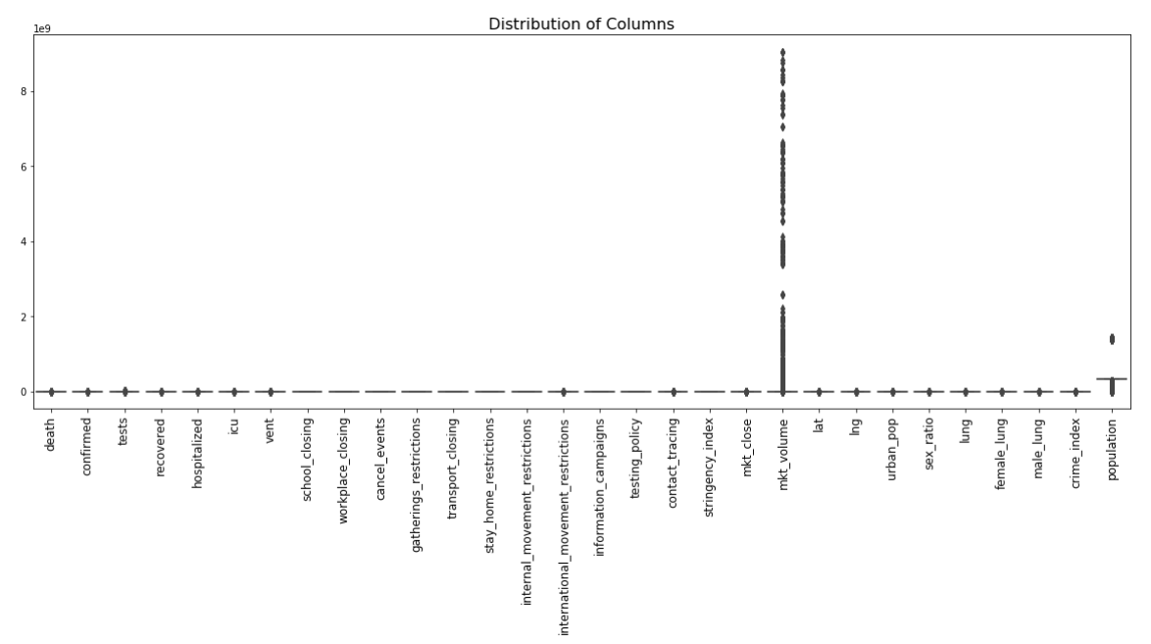
Analyze DATA set:
Columns Distribution:
Stock market volume has the widest distribution.
The average value of most columns is zero.

Slide 7
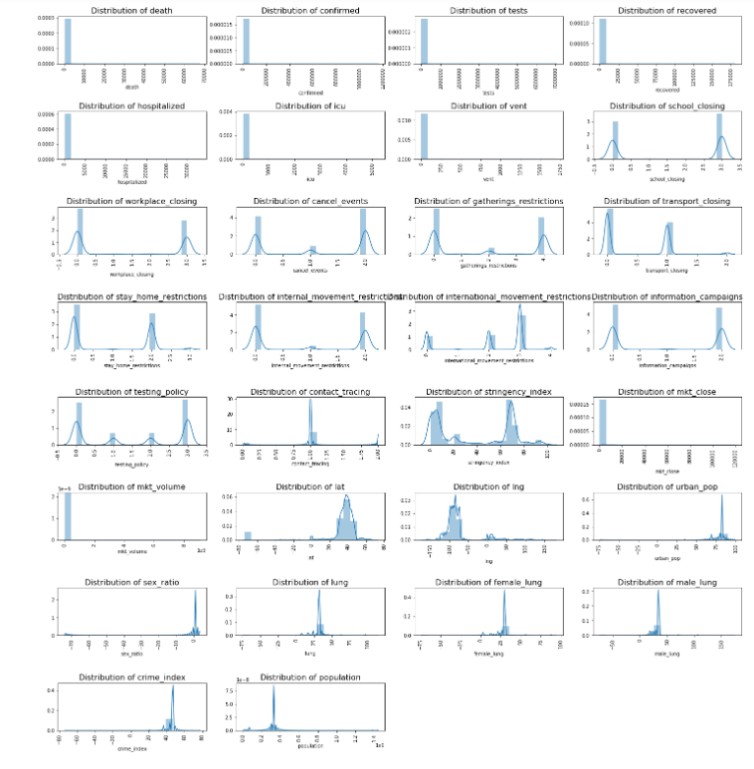
Analyze DATA set

Slide 8
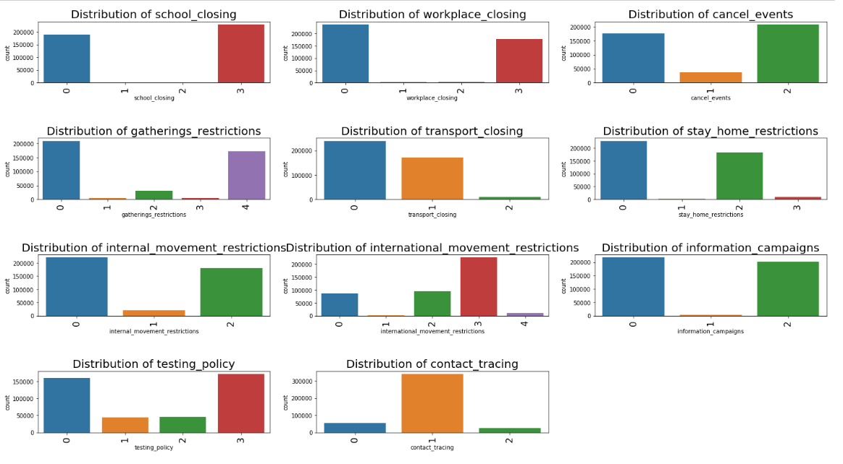
Analyze DATA set
Cancel events: highest for "Require cancelling".
Testing policy: highest for "open public testing".
Contact tracing: highest for "Limited contact tracing".
International_movement_restrictions: highest for "Ban on high-risk regions“.
School closing: highest for "Required" in all level.
Other columns do not have any restrictions.

Slide 9
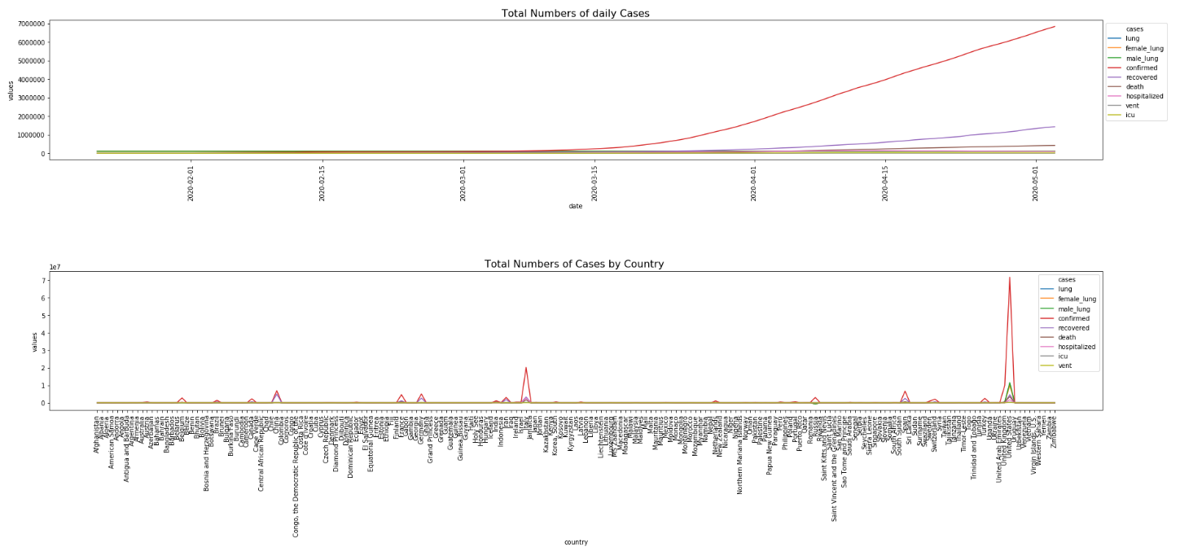
Analyze DATA set
According to daily cases:
The trend of confirmed cases increased rapidly.
The trend of recovered cases increased slowly.
The trend of lung disease, death, icu, vent and hospitalized remained almost constant.
According to cases in different countries:
United State has the highest number of confirmed cases, Italy is second.

Slide 10
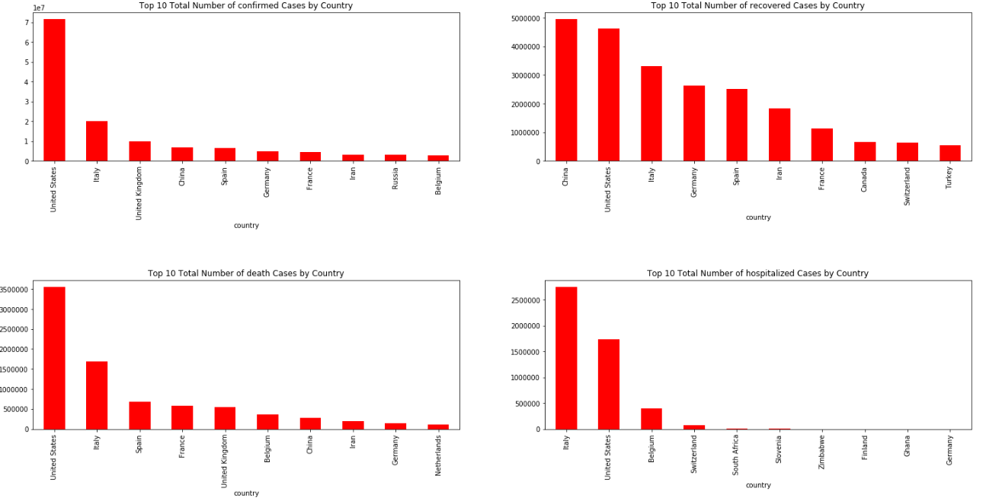
Analyze DATA set
United States has the highest number of confirmed and deaths, then Italy.
China has the highest number of recovered and then United States.
Italy has the highest number of hospitalized and then the United States.

Slide 11

Feature Engineering

Slide 12
Data Preparation
Encoding Categorical Variables
with Factorize
1
Preparing Dataset by Using Standardize
2

Slide 13
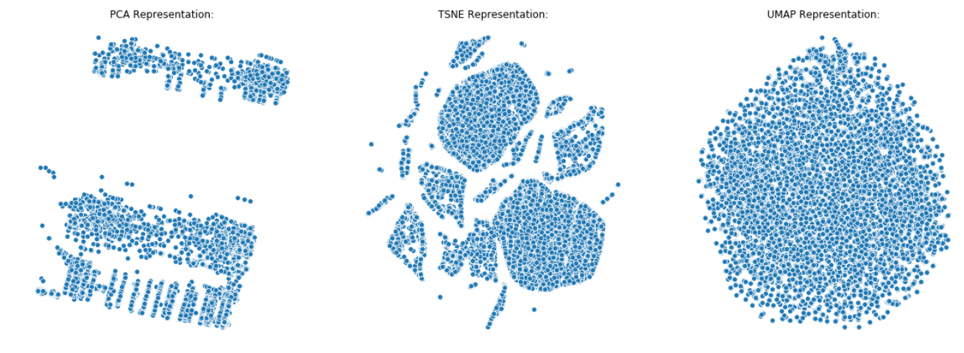
Applying Dimensionality Reduction to Visualize
Principal Components Analysis (PCA)
t-Distributed Stochastic Neighbor Embedding (t-SNE)
Uniform Manifold Approximation and Projection (UMAP)

Slide 14
Dimensional Reduction:
The percentage of total variance in the dataset explained with PCA is around 0.92.
In PCA, time elapsed is much less than TSNE and UMAP. Also UMAP time elapsed is much less than TSNE.
In TSNE we can identify classes quite well in contrast to UMAP and PCA representations.

Slide 15

Modeling

Slide 16
Supervised learning models
Logistic Regression
Random Forest Classifier
Support Vector Classification

Slide 17
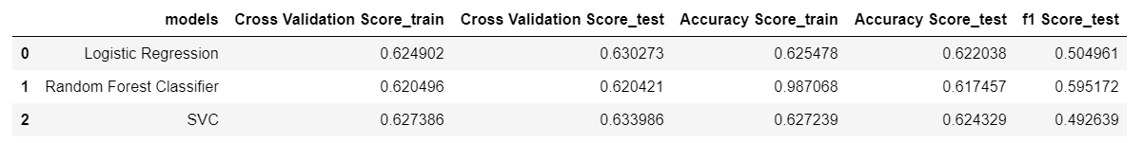
Preliminary Models:
The SVC model is the best fitting model for train and test set.
Random Forest has the highest number of accuracy in train set but the value of test is much lower. So, the Random Forest has the most overfitting model.
Logistic Regression and SVC have almost the same accuracy and f1 score for test set. So both of them are good to use, SVC is slightly better.
Notes:
Sample note

Slide 18
Optimizing Models by PCA
Find out the number of components that explain 90% of variance in the dataset.
Create Data Frame with PCA Components
Adding Target Variable
Applying Models

Slide 19
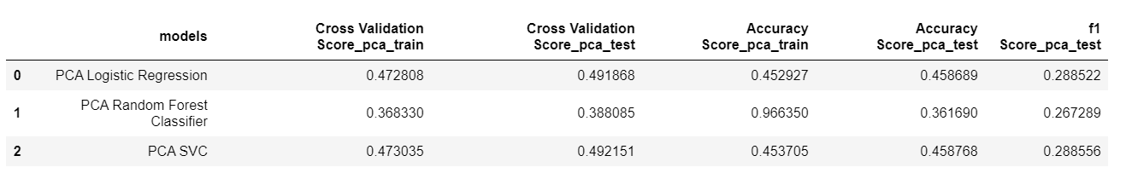
Optimizing Models By PCA Results
The SVC model is the best fitting model for train and test set.
PCA Random forest has the highest number of accuracy score in train set, but the value of test is much lower. So,the PCA Random Forest has the most overfitting model.
PCA Logistic Regression and PCA SVC have almost the same accuracy and f1 score for test set. So both of them are good to use but PCA SVC is slightly better.
The accuracy and f1 score of models after applying PCA is less than primary model. So, PCA does not seem to improve the models.
Notes:
Sample note

Slide 20
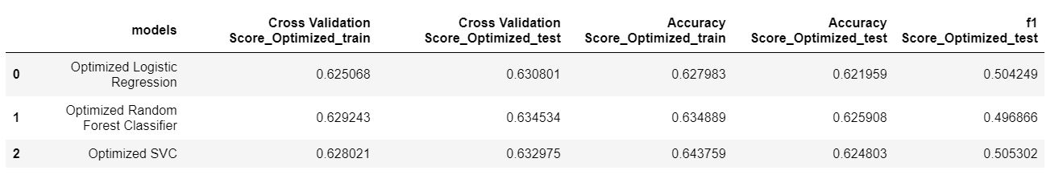
Optimizing Models By Randomized Search Cv.
All results have almost same cross validation score in train and test set, which means fitting models are same.
All results have almost same accuracy for train and test set. So, all models don't have overfitting.
The accuracy score of Optimized Random Forest model in test set is the highest .
The f1 score of Optimized SVC model in test set is the highest, So I choose This model as a best one.
The accuracy and f1 score of models after optimization are a bit better than primary model. So, optimization does improve the models.
Notes:
Sample note

Slide 21
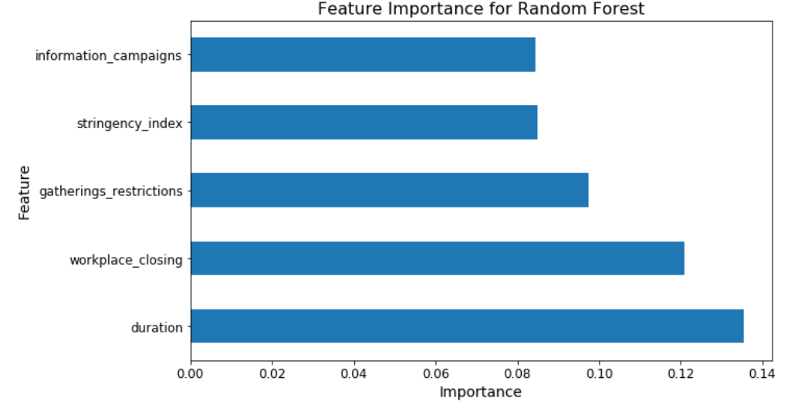
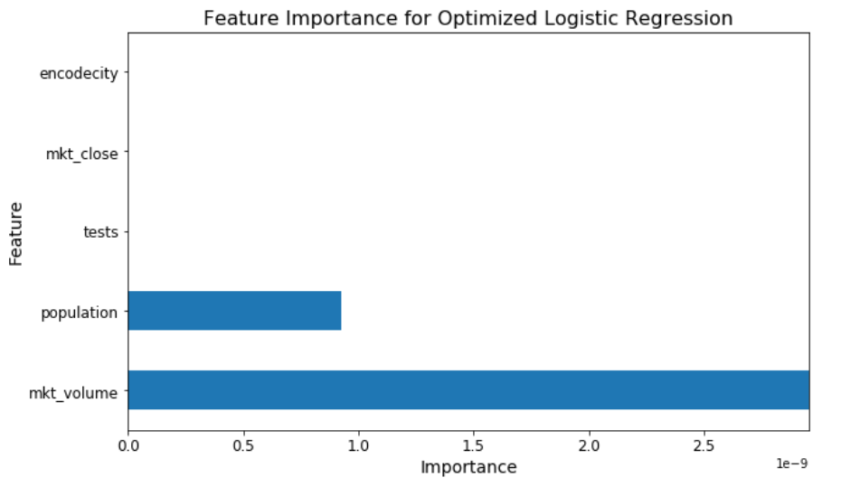
Feature important
Logistic Regression does not have built in feature importance functions. Simple way is to multiply the standard deviation by the coefficients of each feature.
Random Forest has built-in feature importance function.
SVC has only feature important for linear kernel.

Slide 22
Unsupervised learning models(clustering)
Kmeans
Hierarchical clustering
Density-Based Spatial Clustering of Applications with Noise (DBSCAN)
Clustering with Gaussian Mixture Models (GMM)

Slide 23
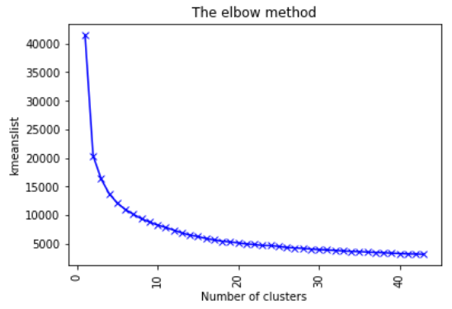
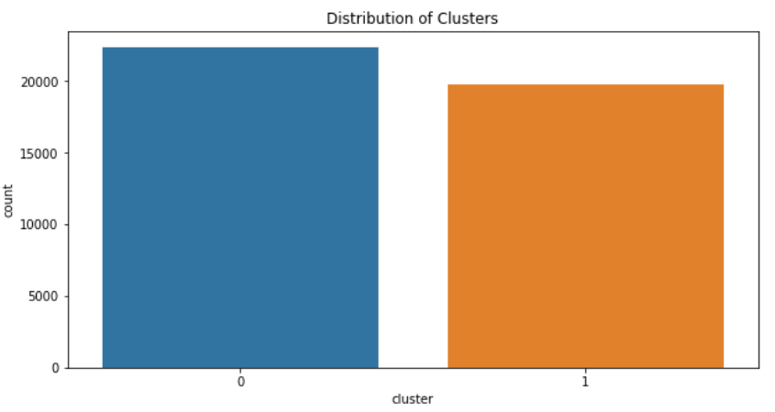
Kmeans Clustering
Finding the Best Number of Clusters with Elbow Method:
Distribution of clusters in Elbow Method:
2

Slide 24
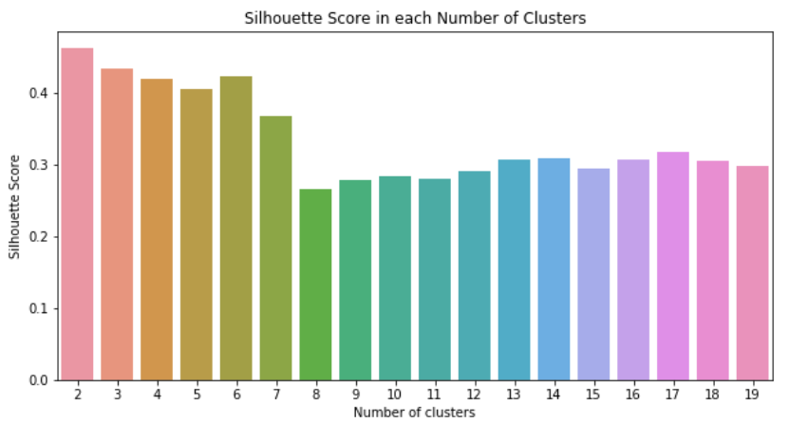
Finding Best Number Of Clusters By Calculating Silhouette Score
The best solution is for the 2 clusters as its silhouette score is the highest.

Slide 25

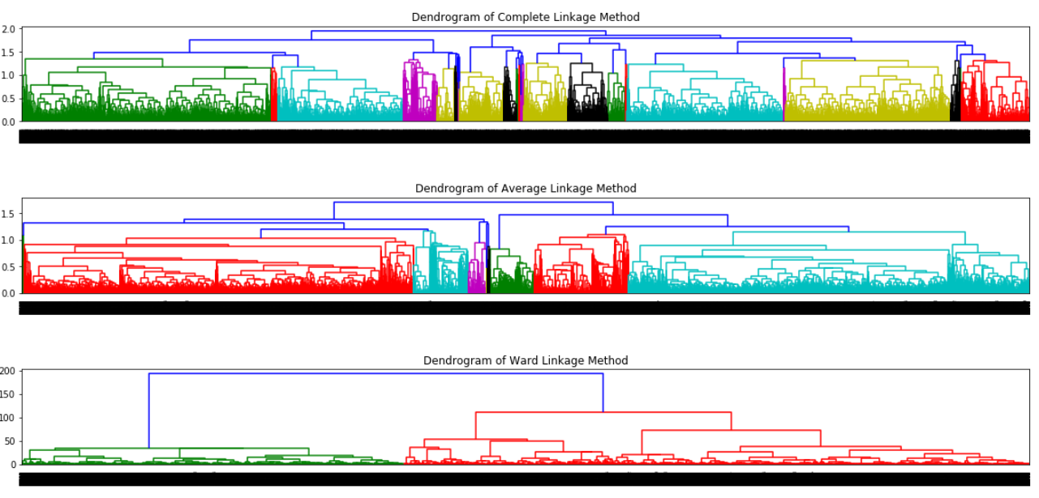
Hierarchical Clustering
Sketch The Dendrogram by Using The Different Linkage Method

Slide 26
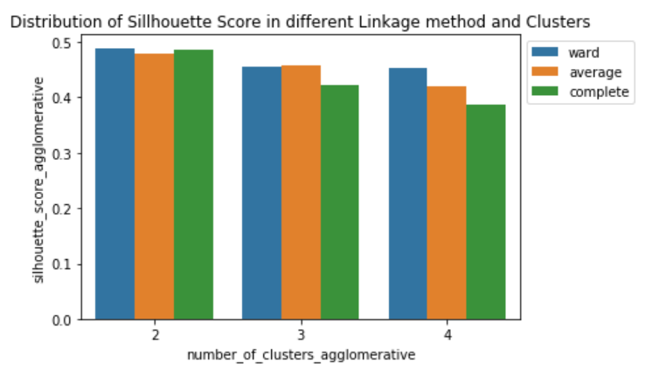
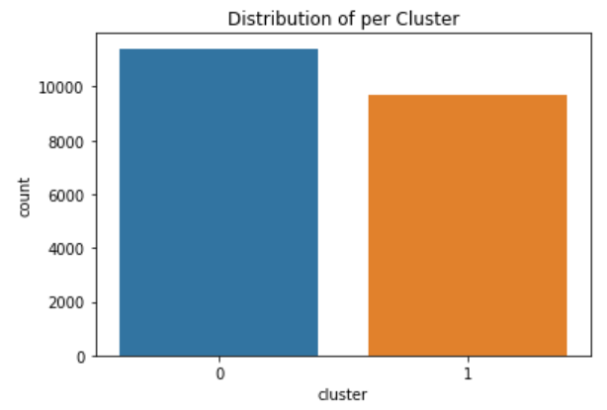
Hierarchical Clustering
The highest number of silhouette score is for number of clusters 2 with ward linkage method.
Distribution of values per cluster is higher in cluster 0, so density is much in the cluster 0.

Slide 27
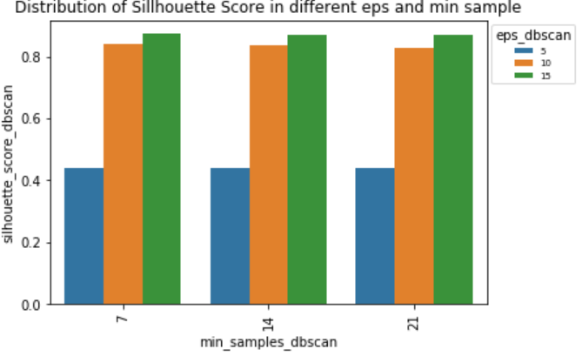
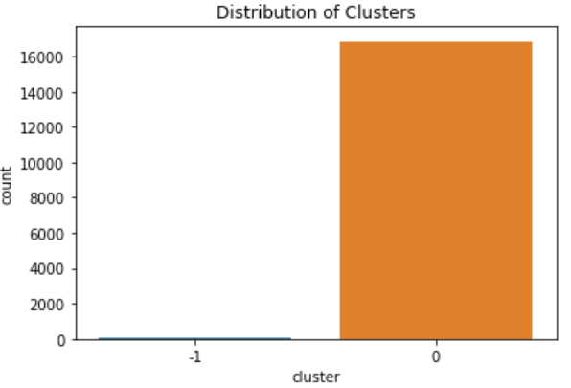
Dbscan clustering
The highest number of silhouette score is for number of clusters 2 with eps=15, min_samples=7.
Density is very much in the one cluster, most of the values are clustered in the one cluster and lower number of variables are as an outlier.

Slide 28
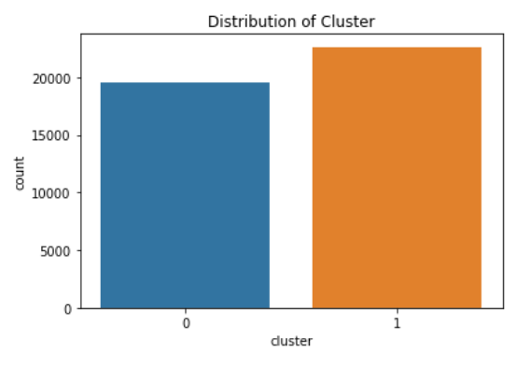
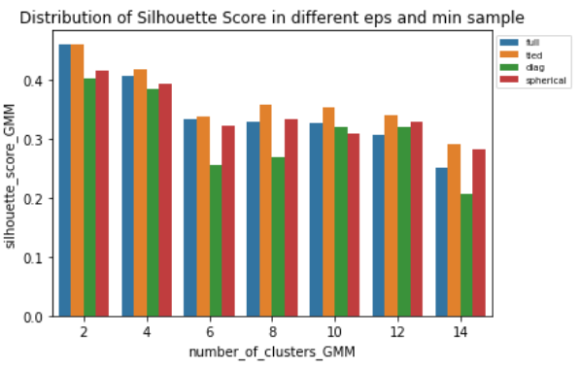
GMM Clustering:
The highest Silhouette Score is for number of 2 clusters and covariance_type of tied.
Number of values per cluster is highest in the cluster 1.

Slide 29
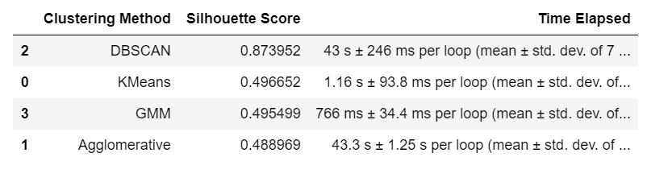
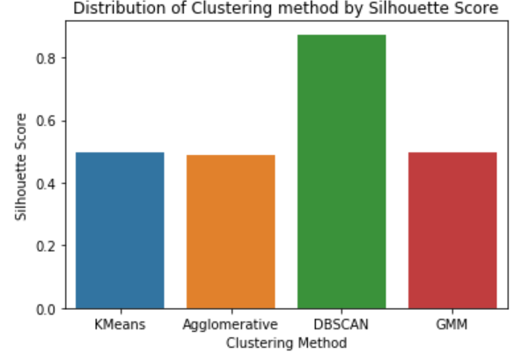
Compare unsupervised learning models
DBSCAN has highest Silhouette Score, but most of the values clustered in the one cluster, so density is very much in the cluster.
The Second Highest Silhouette Score is for Kmeans and GMM.
So I compared the distribution of variables and time elapsed in both clustering methods to find the best one.

Slide 30
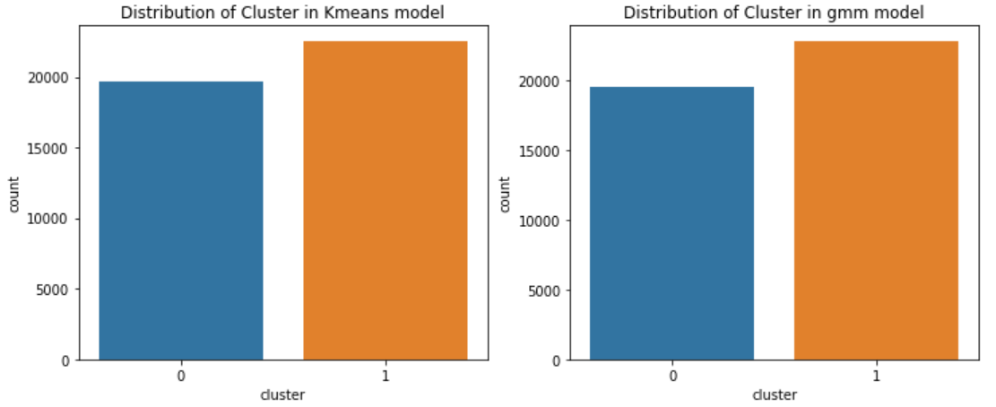
Compare unsupervised learning models
Time Elapsed in GMM method is much less than kmeans method.
The number of values per cluster, distributed almost the same without any density in any cluster.
The GMM method in comparison with kmeans seems a bit suitable in terms of time elapsed.

Slide 31
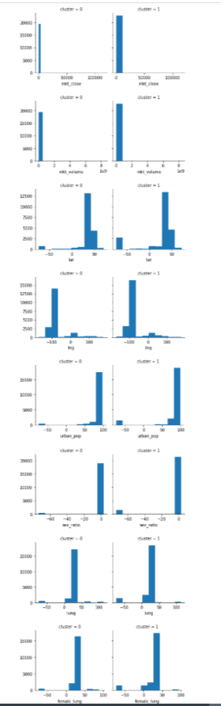
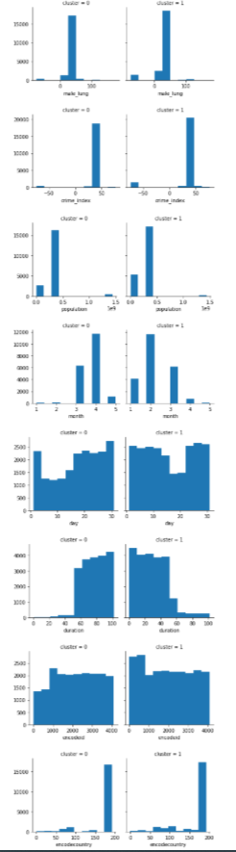
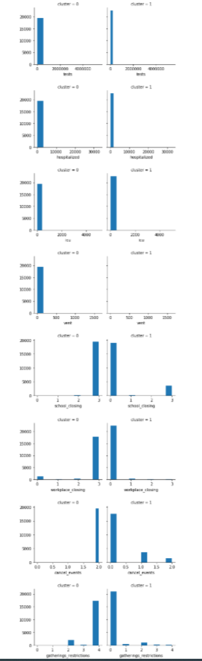
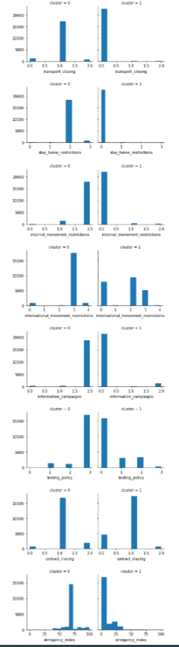
Values distribution per cluster in gmm
Cluster 0: This cluster indicates a group with high hospitalized, icu, vent and more restrictions. We can assume that this group is confirmed as they had covid_19. The number of values in this cluster is slightly lower which is good.
Cluster 1: This cluster indicates a group with low hospitalized, icu, vent and less restrictions. We can assume that this group is not confirmed to get covid_19.

Slide 32
Modeling with pyspark

Slide 33
Supervised learning models with pyspark
Logistic Regression
Random Forest

Slide 34
Supervised learning models with Pyspark:
Applying models
Applying models with Pipeline
Optimized Pipeline models with Cross Validator

Slide 35
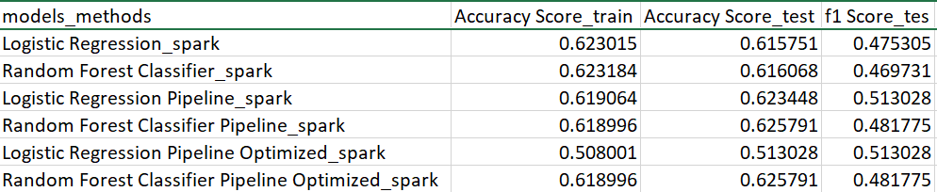
Supervised learning models with Pyspark results:
Logistic Regression and Random Forest Classifier have almost same in accuracy score, but Logistic Regression is slightly higher in f1 score. So, Logistic Regression was selected as the best model.
As expected, by applying Pipeline we got the same results as without it.
Using cross validator to optimize the model does not seem to improve the models as much.

Slide 36
unSupervised learning models with pyspark
KMeans Clustering
Clustering with Gaussian Mixture Models (GMM)

Slide 37
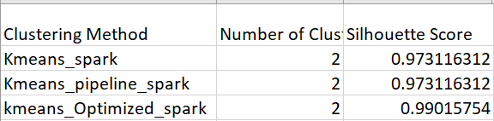
unSupervised learning models with Pyspark results
As expected, by applying Pipeline we got the same results as without it.
By using cross validator the model was optimized.

Slide 38
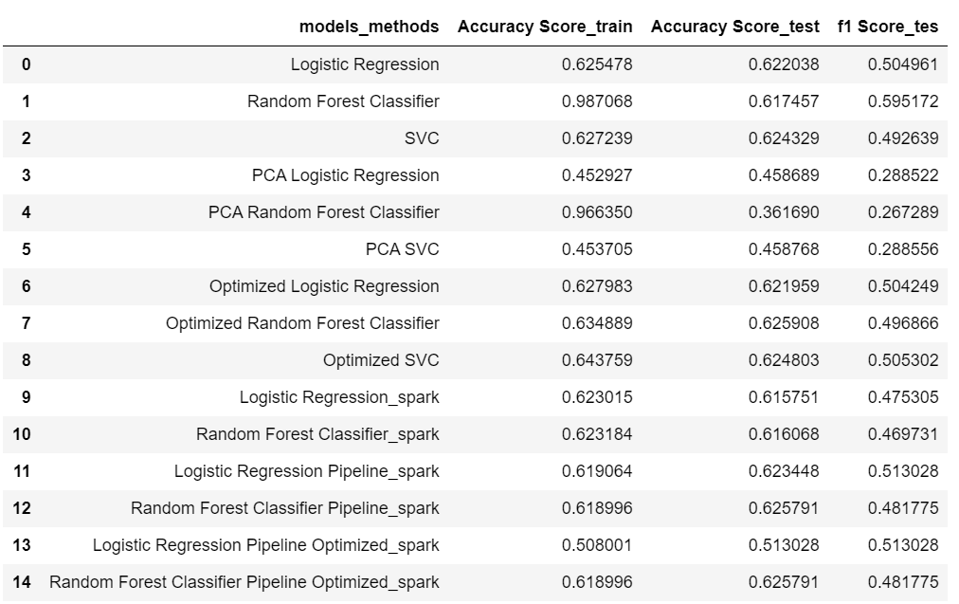
Conclusion:
Supervised models summary results:
The best results obtained after applying Randomized Search as follow:
All results have almost the same cross validation score in train and test set, which means fitting models are the same.
All results have almost the same accuracy for train and test set. So, all models do not have overfitting.
The accuracy score of Optimized Random Forest model in test set is the highest .
The f1 score of Optimized SVC model in test set is the highest, hence it was selected.
By applying Spark, we got almost the same result.

Slide 39
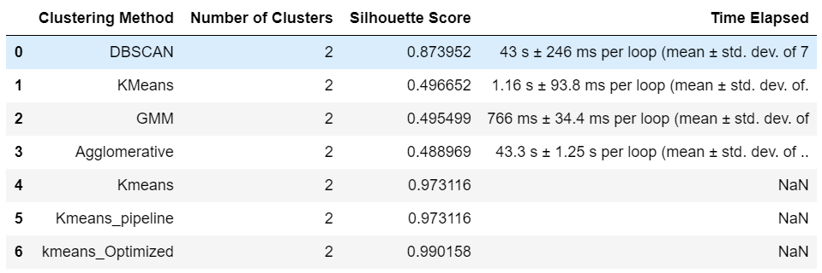
Conclusion:
Unsupervised models summary results:
The best number of cluster is 2.
The number of values distributed per cluster are almost the same without any density in any cluster.
The GMM model in comparison with kmeans seems more suitable in terms of time elapsed.
Kmeans Optimized has better score by using Spark.

Slide 40
Key Takeaways
The purpose of this analysis was to use the available COVID-19 pandemic world data. Recommendations are based on analysis results and my personal interpretations:
United States has the highest number of tests, deaths, confirmed cases, cases in ICUs and on Ventilators.
Italy ranks second in confirmed cases and deaths.
Italy has the highest number of the hospitalized cases and then the United States.
China has the highest number of the recovered cases and then the United States.
Most countries are not enforcing a general quarantine and restriction on social activities such as social distancing, closing schools/workplaces/public areas. The ban has been mostly applied to high-risk regions only.
In general, the trend is towards rapid increase of confirmed cases with recovered cases having a lower rate.
Considering the above, more stringent measures seem to be necessary to control the spread of the Corona virus.

Slide 41
Future works:
Given my limitations, I uses only 10% of the dataset for machine learning models. It will obviously be best to analyze the entire dataset.
Quality of the dataset could have been improved as well, e.g. most of the information is about the United States, more data for other countries could be added to draw broader conclusions.
I used the dataset from 05.05.2020, more tuning, improvement and up-to-date data will be needed for future analysis and iteration.
Analysis of the dataset can be enriched by analyzing risk factors deeper and adding extra risk factors.

Slide 42

Thank you

